Slide 1
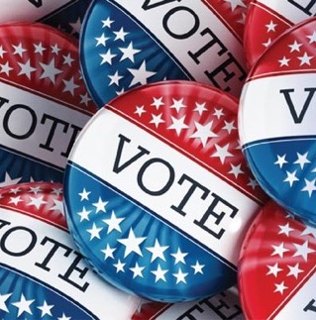

Teacher Package
In the time COVID-19
How to Register
and Vote from Home
More resources
Notes:
(For the teacher) ABOUT THE LESSON:
Objectives: the student will be able to
Register to Vote
Obtain a vote-by-mail ballot
Vote by mail
Help others in their households do all of the above
This lesson is interactive and multi-media (includes videos.) There are several places where you will either use the Zoom white board or enter the PowerPoint edit mode to capture input from students. It’s wise to try out these features before going live.
The lesson can be taught in one session or split into multiple sessions with an experiential homework assignment between. The natural splitting points are after each “Step:” 1. Register; 2. Commit; 3 Vote.
The program includes an “Advocate’s Toolkit” (PowerPoint file) and a Guide (Word file) designed for students to use after this lesson to help others in their households register and vote.
Introduce the lesson
“We’re going to cover material that prepares you for the upcoming elections in this time of the coronavirus crisis.”
“The material has been prepared by the League of Women Voters and before we begin it’s important to know something about the source. The League has been around for 100 years—ever since it was started by the women who fought for the vote. It is a nonpartisan organization—which means it never supports one political party over another or one candidate over the other. The League of Women Voters exists to encourage people to take part in our democracy—to register and vote, to have their voices heard.”

Slide 2
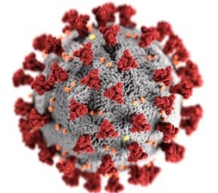
The situation we’re in
We’re staying safe
  Virtual school
  Social distancing
  Masks, hand-washing, . . .
We’re changing/adapting how we vote
  Election-related dates are moving
  The rules have been changed for the July 2020 NJ Primary
  Voting by mail is strongly encouraged
Notes:
Make the point that VOTING CAN’T STOP, EVEN WHEN SOCIETY SHUTS DOWN.
“In this time of the Coronavirus, schools are closed around the nation and the world has come to a standstill. We are staying home and avoiding crowds.”
“But elections must go on, and we could argue that elections are more important now then ever. In the upcoming elections, we will select the leaders who will lead us through this crisis and make the important decisions about dealing with the Coronavirus and the economy—and much more.”
At this time of shutdown, some election dates can change—in fact, the Governor of NJ has already moved the date of the New Jersey Primary from June to July and changed how it will work. But the Presidential (general) election date is set by law as the first Tuesday after the first Monday in November. So the Presidential Election will happen on November 3, 2020 – regardless of whether we are able to move about freely without fear of illness or death.”

Slide 3
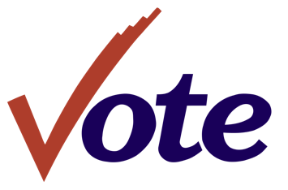
from home
This lesson equips you to handle the situation—
You’ll know
  Why your vote counts
  How to register (and find out if you need to)
  How to cast a ballot by mail (from home)
Notes:
Tell the students: “This lesson is a ‘how-to’ class that prepares you to vote in the upcoming elections safely by using vote-by-mail. We’re going to talk about why your vote counts, how to register to vote, and how to cast a mail-in ballot.”
Define the term BALLOT:
“A ballot is the list of candidates and questions that you use you enter your choices and vote.”

Slide 4

Why bother (to vote)?
Think about the problems in the
world today . . .
What three things do you care about or would like to change?
____________________________
____________________________
____________________________
Notes:
Ask the question on the slide. Prompt with suggestions like the environment, gun safety, public health, etc., if you think the students need help.
Give the students a minute to write down their responses.
When the time is up . . .
Either Press ESC to enter the editing mode OR switch to the White Board feature of Zoom (or your virtual meeting platform.)
Type in the student responses as they offer them.
Summarize: “These are issues that are handled by the people we elect to office.”
Return to the presentation mode by clicking on the small image of the projector screen at the bottom of the screen .

Slide 5






Where are the decisions on these issues made?
Washington (Federal)? Trenton (State)? Freehold (County)? Our town/city (Local)?
The Environment
It’s important to vote in every election: National, State, County, and Local
Notes:
Help students understand that issues are decided at several different levels of government: Federal (Washington), State (Trenton), County (Freehold—for Monmouth County, replace if different county), and Local (school board and town/city council).
Ask students to pick an issue and name the level(s) of government in control. Prompts:
“Are there taxes at the local level? Who makes decisions about what taxes to collect and how they should be used? Is that the only level at which taxes are an issue?“
“At what level of government do you need to vote in order to affect educational issues such as college debt? How about closing a school in your town? What about deciding what graduation requirements are going to be?”
Connect the issue that they care about to the voting process. For example:
Roads and sidewalks are funded at all levels, and sometimes citizens can have a direct say if they want certain infrastructure changes made.
School dress codes can be matter for school boards and superintendents. Citizens elect school board members, and superintendents are appointed by elected officials, so who you vote for matters even at a super local level.

Slide 6

Why is this so important now?
Voters pick the party candidates:
PRIMARY
July 7, 2020
Voters decide:
President and Vice President
Congress—Senate and House
Freeholder
County Clerk and other county officials
Local town/city officials
GENERAL ELECTION November 3, 2020
+
Local School Board
NJ Constitutional Amendments
Property Tax Deduction and Exemption for Peacetime Veterans
Legalize Marijuana
Notes:
[THIS SLIDE IS A BUILD—FIRST THE PRIMARY AND ITS OFFICES (FOR 2020), THEN THE GENERAL AND ITS OFFICES AND QUESTIONS.]
Explain that two elections are coming up and both may be held during coronavirus conditions.
PRESS RETURN: The first is the PRIMARY, which has been moved to July 7.
Define PRIMARY: An election run by each of the two major political parties to pick the candidates who will run for office on their party tickets in the November General Election.
In NJ, you have to identify yourself as a Republican to vote in the Republican Primary or as a Democrat to vote in the Democratic Party. We’ll talk about this again later.
PRESS RETURN: This year, the primary will decide who will be the candidate from that party for president, vice president, …. [listed on slide]
To vote in a primary election, you need to “declare” your political party. The deadline for declaring is 55 days before the Primary. If you did not declare a party when you registered to vote, you can fill out the registration form again and say which party you prefer.
PRESS RETURN: The GENERAL ELECTION is November 3
Define GENERAL ELECTION: Always held the first Tuesday after the first Monday in November. All registered voters can vote. (You don’t have to declare a party.)
PRESS RETURN: This year, in the General Election, you make your choice for [all the positions listed for Primary] plus local town/city councils and school boards in some districts. And this year, you will vote “Yes” or “No” on two NJ constitutional amendments [Read off slide.]

Slide 7

Who is deciding your future?
(That is, who is voting?)
What percentage of people who were eligible to vote do you think actually voted in the last mid-term election (nationwide)?
Notes:
[THIS IS A BUILD. FIRST, JUST THE QUESTION. SECOND, THE GRAPH]
Set up the slide by summarizing the previous discussion: “We’ve talked about how important it is to vote—to have your voice in your future. So, let’s look at who is voting and whose voices are being heard.”
Ask students to guess what percentage of people who were eligible to vote in the last election (2018 midterm election) actually voted. Wait for a bit to give them a chance to think about a number.
Explain that 2018 had the highest number of voters in a non-presidential election in recent history. Then, let the slide reveal that almost half of the eligible population did not vote in 2018. Say: “That means that only half of the country made the decisions that affect all of us.”
If time permits, relate that to the students in the class: “If our class of X number of students represented all the eligible voters in the country, all of us would be governed by the choices made by just half of us—just X people. They would be making the decisions for all of us.”

Slide 8

Who votes?
Does AGE make a difference?
The next four slides show the difference, by age, in the percentage of eligible voters who actually voted in Presidential elections from 1996 through 2016.
Notice how your age group compares to others.
Notes:
Explain to students that they are now going to see four slides that show whether how old you are makes a difference in whether you are likely to vote.
Ask them to pay special attention to the line on the graphs that represents their age group (18-29 year-olds).
[The sequence of slides goes quickly. The first takes a bit longer, since it is where you orient the students to the graph.]

Slide 9

VOTER TURNOUT BY AGE – PRESIDENTIAL ELECTIONS
Notes:
Orient students to the graph. “The graph shows the percent of eligible voters (those who are citizens and at least 18 years old) who voted in Presidential elections between 1996 and 2016.”
Ask what they notice. Possibilities include:
Slight upward trend, basically flat
Highest points was the 2008 election (What was different about this election? Barack O’Bama’s 1st presidential race)
Move quickly through the next three slides . .

Slide 10
VOTER TURNOUT BY AGE – PRESIDENTIAL ELECTIONS
Notes:
Point out that the graph shows the percent of 30 to 44 year-olds who voted in Presidential elections.

Slide 11
VOTER TURNOUT BY AGE – PRESIDENTIAL ELECTIONS
Notes:
Point out that the graph shows the percent of 45-59 year-olds who voted in Presidential elections.

Slide 12
VOTER TURNOUT BY AGE – PRESIDENTIAL ELECTIONS
What do the slides tell you for sure, and what assumptions might you make?
Notes:
Point out that this graph adds the final age group: those 60 years and older.
Ask:
“Take a minute now that you have viewed the four graphs and think about what they tell you.”
“What do the slides tell you for sure, and what assumptions might you make?”
Give the students a minute to write down their responses. Leave this slide up. You will capture their answers on the next slide. When the time is up, move to the next slide and press ESC to enter the editing mode.

Slide 13
What does the graph tell you?
Facts
(What you know for sure)
Assumptions
(What you think might be going on)
____________________________
____________________________
____________________________
____________________________
Notes:
When the time is up, press ESC to enter the editing mode.
Type in the student responses as they offer them.
Summarize: “Basically, we see that the older you are, the more likely you are to vote.”
[IF TIME PERMITS] Let students know that in this coming election, Millennial and Gen Z voters (their age group) will outnumber Baby Boomers (the oldest age group) for the first time. Ask: “Depending on who turns out to vote, how might that change the election outcome? Does that make you realize that you have the power to make a difference with your vote?”
If still in PowerPoint, return to the presentation mode by clicking on the small image of the projector screen at the bottom of the screen
If using the whiteboard, return to the PowerPoint.

Slide 14
Who votes?
Does RACE make a difference?
The next four slides show the difference, by race, in the percentage of eligible voters who actually voted in Presidential elections from 1996 through 2016.
Notice how your race or ethnicity compares to other groups.
Notes:
Explain to students that they will see four slides build again. Ask them to pay attention to the line that represents their race or ethnicity, and to compare their group to the others.
(The groups are determined by the US Census Bureau. Hispanics are considered a separate ethnicity regardless of their skin color. Whites and Blacks numbers exclude Hispanics. The category called “other” includes Asian Americans, Native American, Alaskan Natives, Pacific Islanders and people of mixed race.)

Slide 15
VOTER TURNOUT BY RACE – PRESIDENTIAL ELECTIONS
GOOD
Notes:
Point out that the graph, like the ones we just looked at, shows the percent of eligible voters (citizens at least 18 years old) who voted in PRESIDENTIAL ELECTIONS from 1992 to 2016. This time, instead of representing age groups, the lines represent RACE or ETHNIC GROUP.
Explain the first group is NON-HISPANIC WHITES.
Ask: “What do you notice?” Answers might include:
Basically flat, with a slight upward trend.
Overall, a relatively high percent turnout, compared to what we saw on the age group charts.

Slide 16
VOTER TURNOUT BY RACE– PRESIDENTIAL ELECTIONS
GOOD
Notes:
Explain that this chart adds NON-HISPANIC BLACKS.
Ask for observations. Possible responses:
Generally lower turnout than for whites.
Exception for 2008 and 2012. First time in modern history that the BLACK turnout was higher than WHITE. What might explain that? [Obama in the races.]

Slide 17
VOTER TURNOUT BY RACE– PRESIDENTIAL ELECTIONS
GOOD
Notes:
This chart adds HISPANICS.
Ask them to notice the pattern. [They will have a chance to discuss shortly. You don’t necessarily have to hear from them now.]

Slide 18
VOTER TURNOUT BY RACE– PRESIDENTIAL ELECTIONS
GOOD
What do the slides tell you for sure, and what assumptions might you make?
Notes:
Explain that this chart adds a final line that captures turnout for all other groups (like Native Americans and people of mixed race) who are not included in the other categories.
Ask:
“Take a minute now that you have viewed the four graphs and think about what they tell you.” Prompts:
“What do you realize about your own race or ethnic group compared to the others that are shown?”
“What might have happened if Blacks as a group had turned out as strongly in 2016 as they did in 2008 and 2012? What other assumptions can you reasonably make based on the data here about election outcomes in the future?”
“What do the slides tell you for sure, and what assumptions might you make?”
Give the students a minute to write down their responses. Leave this slide up. You will capture their answers on the next slide. When the time is up, move to the next slide and press ESC to enter the editing mode—or switch to the WHITE BOARD feature of your video conferencing application.

Slide 19
What does the graph tell you?
Facts
(What you know for sure)
Assumptions
(What you think might be going on)
____________________________
____________________________
____________________________
____________________________
Notes:
When the time is up, press ESC to enter the editing mode OR leave the white board and return to the PowerPoint.
Type in the student responses as they offer them.
Summarize: “Basically, we see that the whiter you are, the more likely you are to vote.”

Slide 20

So what?
What happens if you don’t vote?
People in power listen to those who put them there
(the groups who vote.)
The higher the voter turnout, the stronger a group’s voice.
RISK: No vote, no voice.
Notes:
Read the title and bullet points.
“Here’s the point: your vote counts and you do have a voice if you choose to exercise your right to vote in every election.”

Slide 21
How to make your voice heard!
Commit
Vote
Register
1
2
3
Notes:
“Let’s say you’ve decided you want to have a voice in your future. What do you need to do?
Basically, you take three steps: You register. You make a commitment to follow through. And finally, you cast your vote.
We’re going to look at each of these steps and equip you to register and vote from home.”

Slide 22


Can I register to vote?
Yes! If you are . . .
A U.S. citizen
At least 17 years old
(But you can not vote until you turn 18)
A resident of the county for 30 days before the election
Not serving a prison sentence for a felony
NEW ! You can vote if you are on parole or probation but you need to register—even if you were registered before.
Notes:
Read through the requirements to vote in New Jersey. Point out that 17-year-olds can register, but they cannot vote until they turn 18. They must be 18 by Election Day.
Point out that the law changed recently to allow people who have served time in prison for a felony to vote when they are on parole or probation. But they MUST REGISTER or re-register if they were registered to vote when they went to prison.

Slide 23
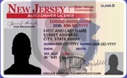
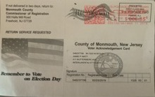

Am I already registered?
If you got your NJ driver’s license since 2018, you were registered to vote—unless you chose to OPT OUT
If you registered, you received a VOTER ACKNOWLEDGMENT CARD in the mail
(you don’t need to have the acknowledgement card to vote)
Once you turn 18, you can check at VOTE411.org
(your name does not appear on the state list until you can actually vote)
If in doubt, REGISTER
Notes:
Share with students that young people were registered to vote automatically if they got their driver’s license or if they have had any other interaction with a government agency -- unless they opted out – meaning they said they did not want to be registered to vote.
If they were registered automatically, they would have received a “Voter Acknowledgement Card” (shown.) Tell them not to worry if they can’t find the card; they don’t need to show it to vote.
Some people will be unsure whether they are or are not registered – both old and young. If they are 18, they can check the official state list online by going to VOTE411.ORG (or even Googling “Am I Registered?”) Unfortunately, they will not show up on the state list even if they are registered until they turn 18 and are actually able to vote.
If students are unsure of their registration status, they should register. It won’t matter that they are already registered.
Tell students that once they are registered, they do not need to reregister except if their name, address, or signature changes or they wish to change their party affiliation.

Slide 24

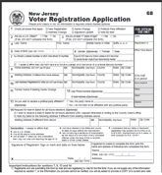
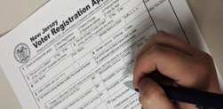
How do I register?
Online registration will be available in NJ in July 2020
Get a registration form
Fill it out
Mail it in
For now
Notes:
Tell students that by mid-July, New Jersey citizens will be able to complete and submit their registration forms electronically. However, we are urging people who will be 18 by July 7 to register NOW for the upcoming primary.
Until we have online registration, the process for registering has three steps:
Get a paper copy of the form.
Fill it out.
Mail it in.

Slide 25
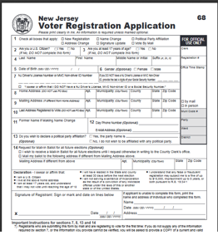
Get the form
In normal times . . .
In these times, from home:
  Print from a website
  https://www.state.nj.us/state/elections/voter-registration.shtml
          --OR--
  Text “REGISTRATION FORM” to the League of Women Voters and they’ll be in touch and mail one to you
    732-927-1131
Notes:
Explain that in normal, non-coronavirus times, you can pick up a registration form at town hall, the library, and registration drives, among other places.
Now, with the restrictions on our movements, picking up forms is not an option.
Here’s what to do to get the registration form from your home:
Go to the state website. (CLICK ON THE HYPERLINK TO DEMONSTRATE.) Scroll to “Monmouth County.”
For languages other than English and Spanish, scroll to ”State Forms” at the bottom of the list of counties.
Fill out the form online and click and print. (It must be printed at 100% size.)
OR (if you don’t have a way to print the form)
TEXT the words “Registration Form” to the League of Women Voters at 732-927-1131. The League will contact you to ask for your name and address and MAIL YOU A REGISTRATION FORM.

Slide 26

Use pen, not pencil!
How to fill out the Voter Registration form
Online form
VIDEO
Notes:
Here you show students how to complete a VOTER REGISTRATION FORM. There are three options for how to do this:
Stay on this slide and talk about each field on the form.
(On some platforms, Note #12 may not be visible. It reads: “Providing both phone number and email is strongly recommended for contact in case of questions or errors on the application.”)
Click on the “Online Form” hyperlink. It will take you to an interactive form which you can fill in, real time, explaining as you go. If this is your choice, print a copy of the slide to support you as you narrate filling in the form. You must be in the “Slideshow” mode for the hyperlink to work.
Click on the “VIDEO” hyperlink and play the League of Women Voters video (~8 minutes) showing someone filling in the form. You must be in the “Slideshow” mode for the hyperlink to work.
NOTE: How you return to the Slideshow from the hyperlinks varies, depending on your hardware and software platforms. How it works for you may influence your choice of option (staying on the slide, filling in the online form and narrating yourself, or showing the video.)

Slide 27
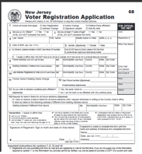

Mail it!
Fold and tape your form and
drop it in a mailbox.
Your form is already addressed and stamped.
Once registered, you stay registered and do
not need to submit another form unless you change your address, name, signature, or party affiliation.
DEADLINE: 21 days before Election Day
June 16, 2020 for the July 7 NJ Primary
October 13, 2020 for the General Election
Notes:
It is vitally important that people follow the directions for submission exactly. If you’re using this presentation to teach remotely, model how to stack, fold, and seal the pages using two sheets of paper.
Demonstrate how to check to be sure the address shows on the outside when it is folded and sealed and how to check to see whether postage needs to be added.
Some young people have told us that they have never been inside a post office since all of their communications are online – and it’s actually intimidating since they have never done so. You can buy stamps online.
Remind students that there are deadlines for registration. To register in NJ, the County Board of Elections must receive your voter registration application 21 days before the election. Point out the dates for this year’s upcoming elections, but remind students that the dates change every year.

Slide 28
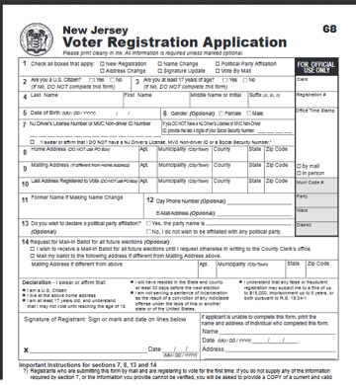
HOMEWORK
Find the registration form on https://www.state.nj.us/state/elections/voter-registration.shtml
Complete the form online and keep track of any questions, problems, or observations
OPTIONAL: Print the form if you are able
Be prepared to report your experience filling the form at our next class
Notes:
USE THIS SLIDE IF YOU ARE SPLITTING THE LESSON INTO MULTIPLE SESSIONS. IF YOU ARE NOT SPLITTING, HIDE THIS SLIDE [BY CHOOSING “HIDE SLIDE” ON THE “SLIDE SHOW” MENU.]
Explain the assignment as laid out on the slide. Students can Google “NJ Registration Form” to get to the state website whose URL is shown on the slide.
Start the next session with this slide and ask students for their feedback, answering any questions and addressing any problems they had.

Slide 29
Next . . .
Commit
Vote
Register
2
1
3
Notes:
“OK! You are registered to vote! Congratulations! Now what? COMMIT! “
[BACKGROUND: Research shows that there is a significant gap between young people’s intention to vote and their follow-through to actually cast a ballot. The distractions of their everyday lives, the barriers to first-time voters, and lower levels of self-discipline and persistence all combine to make this age group chronically the lowest to turn out at the polls. The COMMIT step helps them anticipate and plan to cast a ballot—a step that appears to improve turnout.]

Slide 30


Make a plan
When is the election?
  July 7 Primary
  November 3 General
How will I vote?
By mail? In person?
If by mail, how do I get a mail-in ballot?
How will I know who and what to vote for?
Notes:
Explain: “Especially for those voting for the first time, or voting for the first time by mail, it can be a little scary. “ READ THE QUESTIONS ON THE SLIDE.
Assure the students: “We’re going to take a few minutes to help take the mystery out of voting and casting a ballot by mail.”

Slide 31

Can I vote in the Primary?
For the 2020 Primary ONLY, unaffiliated voters will automatically receive an application for a mail-in ballot. It will have a place to declare your party if you choose to vote in the Primary.
PRIMARY
July 7, 2020
You must declare as either a Democrat or Republican.
You stay affiliated with that party until you submit paperwork to change to “unaffiliated” or to a different party.
(due at least 55 days before the Primary)
Notes:
”If you have registered and will be at least 18 on July 7, you are eligible to vote in the New Jersey Primary. Because of the COVID crisis, the Governor moved the date of the Primary from June to July 7. This is good news for those of you who will turn 18 between June 2 and July 7!
The Primary is an election run by the major parties—the Democrats and the Republicans—to choose their candidates to run in the General Election in November.
In New Jersey, you can’t vote in the Primary unless you DECLARE your PARTY AFFILILATION. That means, you have to officially say whether you are a Democrat or Republican. (You can do this when you register or at a later time by using the voter registration form and checking the box “Political Party Affiliation.”)
IF YOU DON’T CHOOSE TO VOTE IN THE PRIMARY, you don’t have to say whether you are a Democrat, Republican, or some other party. You can be UNAFFILIATED. (UNAFFILIATED means you are not identifying with any party. It is not the same as INDEPENDENT! Independent can be the name of a party.)
One more thing, once you officially declare your party, you stay registered as a member of that party until you submit a change. This must be done on paper. It can’t be done at the polls. Your paper request for a change of party must be received 55 days before the Primary.

Slide 32
July 7, 2020 PRIMARY
In person or by mail?
RECOMMENDED
In Person
By Mail
Special process for this Primary
Special process for this Primary
Ballots mailed automatically to registered Dems and Reps
Special vote-by-mail applications mailed automatically to unaffiliated registered voters
Fewer polling places
A least one in each town
Paper (provisional) ballots
Machine for voters with special needs
All standard Covid-19 precautions
Notes:
IF YOU VOTE BY MAIL, DO NOT GO TO THE POLLS TO VOTE IN PERSON. IF YOU RECEIVE A MAIL-IN BALLOT AND CHOOSE INSTEAD TO VOTE IN PERSON, YOU CAN CAST A PROVISIONAL BALLOT. ONCE OFFICIALS CONFIRM YOU HAVENT VOTED BY MAIL, YOUR VOTE WILL BE COUNTED.
Note (if asked)
For the upcoming July 7 Primary, the rules for both In-Person and By-Mail voting are changed to keep voters and poll workers safe.
It will still be possible to vote in person, but there will be fewer polling places (where you go to vote.) Everyone at the polling place will vote on a paper ballot—called a provisional ballot. Only people with special needs, for whom voting on a paper ballot is a hardship —like the blind, will vote by machine at the polls. All the Covid-19 rules—like 6-ft. social distancing, wearing masks, sanitizing the polling place, etc.—will be in force.
The League of Women Voters and the election officials STRONGLY RECOMMEND voting by mail in the July Primary. To make that recommendation work, the process has been modified, and we’ll go into those changes in more detail in a few minutes. For now, to summarize (remember that only voters who have declared as a Democrat or Republican can vote in the Primary):
Democrats will automatically receive a vote-by-mail Democratic ballot
Republicans will automatically receive a vote-by-mail Republican ballot
Unaffiliated voters (those who have not declared for any party) will automatically receive a postage-paid, self-addressed application for a vote-by-mail ballot to fill out and mail.

Slide 33
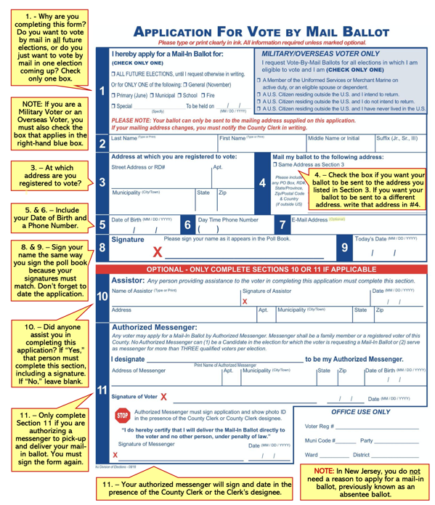
How do I fill out the Vote-by-Mail application?
There will be a customized application for Vote-by-Mail Ballot for the July 2020 Primary ONLY. It will have a place to declare your party, if you want to vote in the Primary.
Notes:
Explain that “the basic purpose of the application is to give the County the address where you want your mail-in-ballot to go. Right now, it is probably your home address, but if you are going away to college next year, you would give them your college address for the November election.
The County will check that you are a registered voter and send you your mail-in ballot. “
Guide students through the form, using the information in the yellow bubbles on the slide.
ALL UNAFFILIATED REGISTERED VOTERS WILL BE MAILED APPLICATIONS FOR VOTE-BY-MAIL BALLOTS FOR THE 2020 PRIMARY. THE APPLICATION WILL INCLUDE A PLACE TO DECLARE YOUR PARTY AFFILIATION (IF YOU CHOOSE TO VOTE IN THE PRIMARY.)

Slide 34
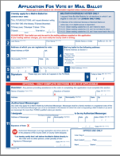

Mail the application for a vote-by-mail ballot
Fold and tape your form and drop it in a mailbox.
Your form is already addressed and stamped.
You will receive your mail-in ballot by mail in time to cast your ballot in the election.
DEADLINE: The County election office must receive your application in the mail at least 7 days before the election.
(IN NORMAL TIMES, a voter can apply in person to the County Clerk in Freehold up to 3 p.m. the day before the election.)
34
Notes:
Your application for a vote-by-mail ballot is self addressed, and for the 2020 Primary, it is also postage paid.
All you need to do is drop the application in the mail before the deadline (at least seven days before the election.) Because of the unusually large number of vote-by-mail applications expected for the 2020 Primary, mail your application as early as possible.

Slide 35
Who should I vote for?
Find candidates who share your values and priorities.
Vote411.com can help
Detailed candidate information at all levels
Information about ballot questions
COVID-19 related changes to election dates and processes
On VOTE411, you also can:
Check registration status
Get a mail-in ballot application
Find a first-time voter checklist
Notes:
VOTE411.org is the League of Women Voters nonpartisan voters guide that provides customized information on voting. Users enter their address and can see what will be on their ballot when they vote. They can see biographical information and answers to League-posed questions from the candidates who respond to the League’s invitation to participate.
VOTE411 provides candidate information down to the local level, information on ballot issues, updates on COVID-19-related changes to elections, and links that allow users to check their registration status and much more.

Slide 36
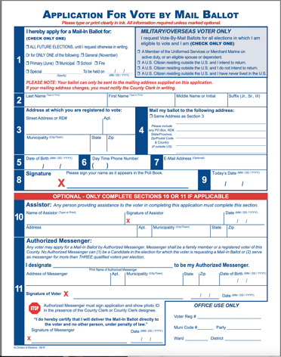
HOMEWORK
Find the Vote-By-Mail application on https://www.state.nj.us/state/elections/voter-registration.shtml
If you are able, print and complete the form keeping track of any questions, problems, or observations.
OR –
  If you cannot print, read the form to ensure you would be able to fill it out, keeping track of any questions, problems, or observations.
Be prepared to report your experience filling the form at our next class.
Notes:
USE THIS SLIDE IF YOU ARE SPLITTING THE LESSON INTO MULTIPLE SESSIONS. IF YOU ARE NOT SPLITTING, HIDE THIS SLIDE [BY CHOOSING “HIDE SLIDE” ON THE “SLIDE SHOW” MENU.]
Explain the assignment as laid out on the slide.
Start the next session with this slide and ask students for their feedback, answering any questions/problems they have.

Slide 37
Next . . .
3
VOTE
2
1
Register
COMMIT
Notes:
”So far, you learned how to register to vote, how to apply for a mail-in ballot and find out about the candidates. You’re ready for the final step: VOTE.
In this section, you will learn how to fill out and cast the mail-in ballot you will receive after you submit your application as we’ve just learned how to do.”

Slide 38

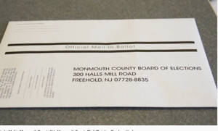
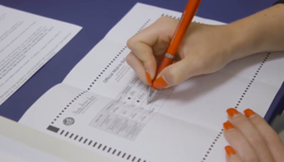
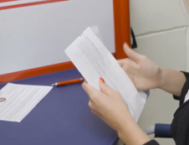
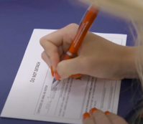
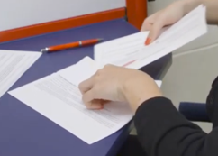
How do I fill out the
Vote-by-Mail ballot?
1
2
VIDEO
How to vote by mail
You’ll receive a package in the mail.
It contains your ballot and two envelopes.
Fill in the circles on the ballot to mark your choices. Use a blue or black pen—not pencil or marker. The ballots are scanned by machine.
3
4
5
Put the ballot in the smaller envelope. Do not detach or damage the flap!
Complete the information on the outside of the smaller envelope and sign.
Place the smaller envelope in the larger envelope and seal.
It is self-addressed and stamped.
38
Notes:
Here you show students how to complete a Mail-in Ballot. There are two options for how to do this:
Stay on this slide and talk students through the basic steps.
Click on the “VIDEO” hyperlink and play the Monmouth County Clerk video (~2 minutes) on Voting By Mail in Monmouth County. You must be in the “Slideshow” mode for the hyperlink to work.
NOTE: How you return to the Slideshow from the hyperlink varies, depending on your hardware and software platforms. How it works for you may influence your choice of option (do-it-yourself or video).
You are allowed to help someone with the mechanics of filling out their ballot. You are NOT allowed, however, to cast a vote for someone else. If you have helped someone (for example: by reading the ballot aloud, by explaining the boxes to check, by pointing out where to sign, etc.) you must sign the area indicated on the inner envelope.

Slide 39

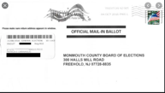
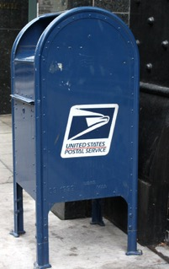
Mail it!
For the July 2020 Primary the County will also set up secure DROP-OFF SITES where you can deliver your ballot.
Drop your ballot in a mailbox or drop-off site
Congratulations, you’ve cast your VOTE!
DEADLINE: Postmarked by Election Day.
For 2020 Primary, deadline for receipt by
County is 7 days after polls close.
MAIL EARLY TO AVOID ANY PROBLEMS!!!!!!!!
Changed from 2 days for the 2020 Primary
Notes:
For the 2020 Primary, secure DROP-OFF sites will be set up around the County where you can take your mail-in ballot. If you have texted the League of Women Voters at 732-927-1131 for any reason, the League will alert you by text to any changes to the process.
You can also can mail your ballot directly to the County. The state has arranged for the postage to be paid on mail-in ballots for the 2020 Primary and General Election. You do not have to put any stamps on the envelope.
Normally, the County will accept ballots up to 48 hours after Election Day IF THE BALLOTS WERE POSTMARKED BY ELECTION DAY. For the 2020 NJ Primary, that deadline has been extended to seven days after the polls close to accommodate the volume of mail-in ballots expected based on the changes to this year’s process. To avoid any problem, mail your ballot well in advance.

Slide 40
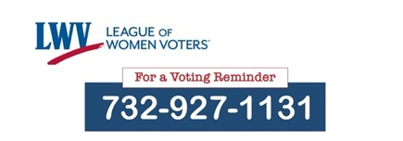
THE BIG IDEAS
1
2
3
Register
Commit
Vote
At least 17 and a citizen
Forms available online and from LWV
DEADLINE: 21 days before election
Apply for a vote-by-mail ballot (online and from LWV)
DEADLINE: 7 days before Election
Complete your mail-in ballot
Mail your ballot
DEADLINE: Postmarked no later than Election Day
Text for help
Notes:
This slide is a build showing one step at a time.
Read though the main take-aways for each step.
Encourage students, if they haven’t already, to text the League of Women Voters NOW. If they simply text the word VOTE, the League will text the reminders about deadlines, etc., and information about any changes to the election process—including when online voter registration will be available. (This service is available to everyone—including teachers.)

Slide 41

Do you know . . .
What is a Primary Election? In NJ, who can vote
in a Primary?
Where can you get a copy of the voter registration form?
What is the deadline for mailing a vote-by-mail ballot?
Who can you text for help about voting? Where can you find that text number?
Why is it extra important this year to be a voting advocate?
Where can you find information to help you help others register and vote?
Notes:
Answers:
The Primary is the election where voters choose who will be the Democratic and Republican candidates in the General (November) Election. In NJ, you must be a Democrat to vote in the Democratic Primary or a Republican to vote in the Republican Primary.
There are several ways to get a Voter Registration form. It is available online at the state elections website. An easy way to find it is to Google: NJ Voter Registration form.
Your vote-by-mail ballot must be postmarked by Election Day. Vote early to be safe!
The League of Women Voters have a dedicated TEXT number 732-927-1131. Text to ask for the help you need. The number is in your Student Voting Toolkit.
The Coronavirus shutdown has changed how we vote and many people will be needing information and support. You have learned what you need to know and have a Toolkit to help them. These changes are happening in a Presidential election year. The future will be determined by those who vote this year.
Your Student Voting Advocate Toolkit is available at [school student portal]

Slide 42
Be a Voting Advocate
Help others register and vote from home
Commit
Vote
Register
1
2
3
BECOME A VOTING ADVOCATE
Apply what you’ve learned to help the people in your household
There is a Toolkit to help you
  [LINK TO TOOLKIT]
Report back and tell us your experience
ENTER THE VOTING MEME/TIKTOK CONTEST
Your Advocate Toolkit has the information you need to talk with others about voting.
Create a meme or TikTok encouraging your peers to register and vote
Enter it at _____________________________
Your classmates will pick a winner
Notes:
BEFORE THE LESSON, 1) POST THE ADVOCATE TOOLKIT, AVAILABLE AT LWVSMC.ORG, ON THE SCHOOL’S SITE WHERE IT IS EASILY ACCESSIBLE TO STUDENTS; 2) CREATE A WAY FOR STUDENTS TO POST THEIR MEMES
Assure students that they’ve learned what they need to know to register to vote from home—and they can text to request support from the League of Women Voters if they need to.
Explain that they have the opportunity to apply what they’ve learned to support the people in their households. Due to stay-in-place orders, many parents, step-parents, grandparents, aunts, uncles, cousins and older friends will have to vote-by-mail for the first time. They can help their loved ones who are old enough and citizens to register (if they are not already) and vote by-mail (which may be a new experience for them).
HOMEWORK
BECOME A VOTING ADVOCATE
Show the students where to find the Toolkit and scan the slides to show them what’s there for them to use. Emphasize that THEY should reach out because older voters may be embarrassed to ask for help, but will gladly accept it if someone they love/respect offers it.
Choose one Section of the Toolkit (Step One: Register, Step Two: Commit, Step Three: Vote)
Prepare to discuss this Section with another student
We will “practice” in our next class—you will have a chance to present your Section to another student of your choice.
ENTER THE VOTING MEME/TikTok CONTEST
Steps are outlined on slide. Let them know how to submit entries (possibly as they do homework assignments.)
Follow up during the next lesson by holding a vote for the best meme and TikTok. Consider how you will recognize the winner.
At the next lesson, ask all students to post the winning meme on their social media.

